Slide 1
Home insurance analysis datasource: https://www.kaggle.com/ycanario/home-insurance Daniel Balseanu

Slide 2
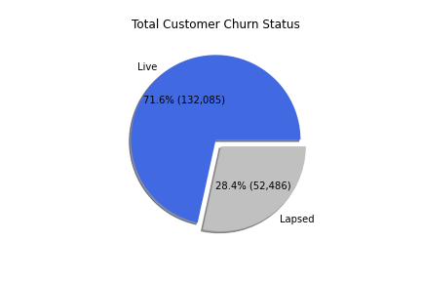
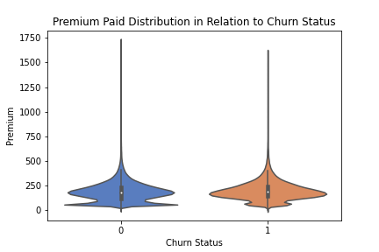
Data Analysis Policy Status
Initial Observations
Total of 184,571 Policies analysed after data cleansing, 28.4% total churned.
Premium would be an obvious culprit: distribution shows skewed number of active customers with a small premium.
No significant statistical correlations between Policy Status and other features.

Slide 3
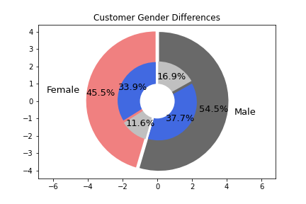
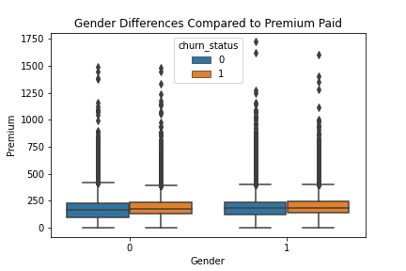
Data Analysis Gender
Is gender relevant? E.g. Risk related tendencies
A proportionally greater part of the males are churned when compared to females.
In relation to premium, tendency for active policy female customers to pay less premium.

Slide 4
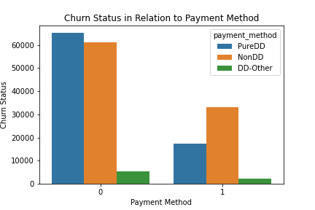
Data Analysis Payment Method
Recursive payment methods generally reduce friction and potential churn.
Greater proportion of non direct debit customers are no longer active.

Slide 5
Model Architecture
Gradient Boosted Trees
Churn Probability
+
Active Probability
Neural Network
Final Churn Prediction
Random Forest
Churn Probability
+
Active Probability
1st Predictive Layer: XGBoost and Random Forest models provide initial class probabilities.
2nd Predictive Layer: Stacked Neural Network aggregates initial predictions.
Data split into multiple parts: train (75%), validation (12.5%), test (12.5%).
Data preparation: mean encoding categorical variables, binary encoding variables with 2 levels, minimal outlier removal and missing data imputation for Random Forest model.

Slide 6
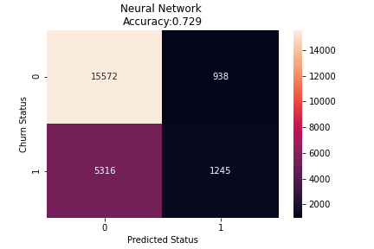
Model Results Test data
Metric | Random Forest | XGBoost | Neural Network
Recall | 0.02 | 0.16 | 0.19
Precision | 0.8 | 0.58 | 0.57
F1 Score | 0.05 | 0.25 | 0.28
Recall: How many actually churned customers did we predict?
Precision: From the customers that we predicted will churn, how many actually churned?
F1 Score: Blends Recall and Precision in a general score
On the test set models perform only slightly worse, F1 score on the training set being 0.30

Slide 7
Cost Benefit Analysis
Churn Rate (Years)
9.5%
Lifetime (Years)
CLTV
£1962
10.5
Gross Premium Lost
+£1.9 Mil
Given the total Live vs Lapsed customers, the estimated Churn rate is 9.5% with a life time of 10.5 years.
Based on the test set predicted churns, gross premium value lost is £1.9 mil.
Potential estimated net value 10%: £190,243 or £153 per customer retained.
Further considerations:
Recursive challenge: if we decrease churn rate, then the LTV calculations are under estimated while also having fewer lapsed policies to predict.
Is there a cost to customers that are incorrectly predicted as churned?

Slide 8

Conclusion
Are the models created on an inherently biased premise?
The data provided is collected post customer lapse – does it actually have predictive power?
Need to establish causation – what happened prior to churn?
(© stock.adobe.com)

Slide 9


Different Perspective
Customer State 1
Married
No Claims
Good Financial Situation
Policy year 1
Customer State 2
Divorced
Claims made
Mediocre Financial Situation
Policy year 2
Customer Lapsed
Customers have a specific timeline leading to churn. Modelling data this way allows potential for different approaches:
Generative Bayesian Multi Armed Bandit
Reinforcement Learning
Other potential features:
Interactions with the insurance provider: complaints, emails, phone calls, claims, website visits
Socio-economic dimensions: income, family size, moving home

Slide 10
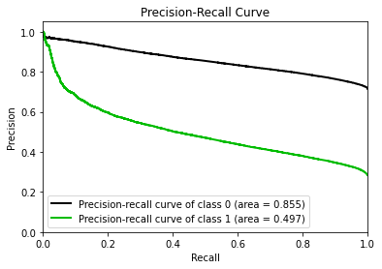
Other Notes
Code modular, documentation provided.
All models and reports are saved, results can be reproduced.
Plug in new data.csv and run main.py it will produce a new up to date model.
XGBoost model hyper parameter tuning done with cross validation implementation.
What about the unit tests?
Feature selection can be improved, difficult to optimize due to few continuous dimensions.
Predictions thresholds at 0.5, however can be altered to potentially increase Recall at the cost of Precision (PR Curve more useful than ROC for this analysis).

